Slide 1
STEM Careers
Party Pack

Slide 2
What is STEM?
Science
Technology
Engineering
Mathematics
“In a world that’s becoming increasingly complex, where success is driven not only by what you know, but by what you can do with what you know, it’s more important than ever for our youth to be equipped with the knowledge and skills to solve tough problems, gather and evaluate evidence, and make sense of information. These are the types of skills that students learn by studying science, technology, engineering, and math—subjects collectively known as STEM.” –US Department of Education
Notes:
http://www.ed.gov/stem

Slide 3
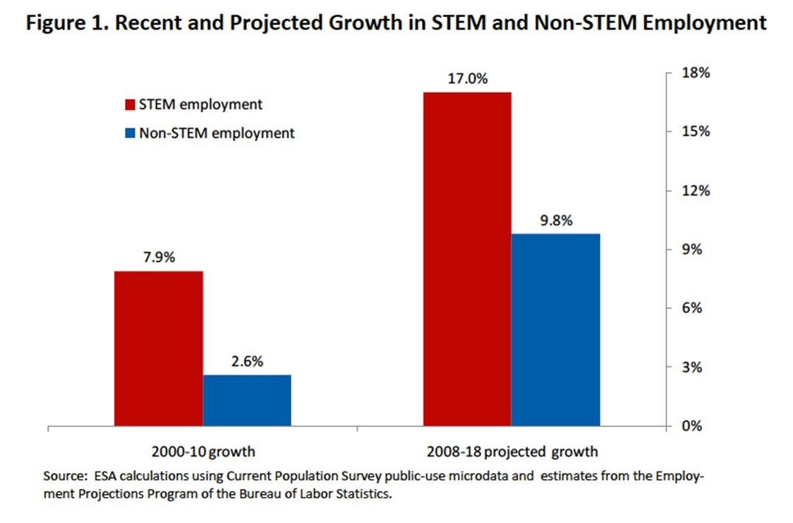
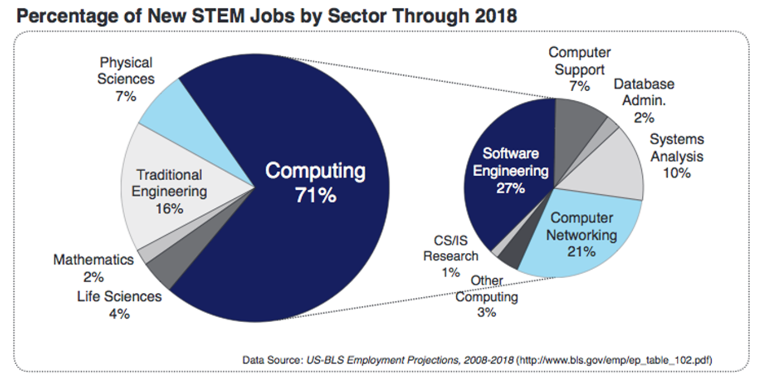
Job Growth in STEM

Slide 4
STEM Career Facts!
The United States ranks 20th among all nations in the proportion of 24-year-olds who earn degrees in natural science or engineering.
The United States ranked 28th in math literacy and 24th in science literacy, according to a 2008 report by the Congressional Research Service.
During the next decade, the United States demand for scientists and engineers is expected to increase at four times the rate for all other occupations.
More than 50 percent of all engineering doctoral degrees awarded by United States engineering colleges are to foreign nationals.
Not enough students are graduating with STEM backgrounds to fill the open positions in the marketplace.
More than half of teens (55%) would be more interested in STEM simply by having teachers who enjoy the subjects they teach
By 2010, if current trends continue, more than 90 percent of all scientists and engineers in the world will be living in Asia.
Notes:
http://stemcareer.com/stem-fast-facts/

Slide 5
Pick a category to further explore STEM careers!

Slide 6
Women in STEM !
Click here to read the article!

