Slide 1
IMPETUS CHECK-IN Party Pack

Slide 2
IMPETUS Program
Throughout the year, students are encouraged to participate in the following:
Rollercoaster Competition (RCC)
Clarkson Discovery Challenge (CDC)
Integrated Clarkson Experience (ICE)
Problem of the Week (POW)
Khan Academy Challenge (KAC)
Clarkson Campus visits
After-school program
And much more!

Slide 3
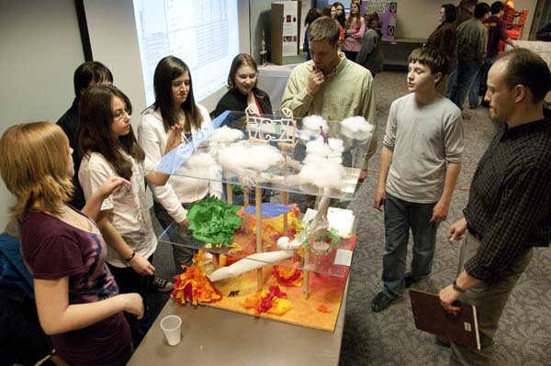
Rollercoaster Competition
The RCC and showcase in April is one of the most popular parts of the IMPETUS program!
Watch this video!
The Engineering Workbook is worth 25 points toward your RCC score!
The workbook is also a great guide to help you get started with designing and planning (engineering!) your coaster
Have you started it yet?

Slide 4
Getting started with the RCC
If you haven’t already, go to the IMPETUS Moodle page and locate the Engineering Workbook course!
Once you’ve found it, complete:
“How to use the Engineering Workbook”
“Judging Criteria”
“Initial Team Registration”

Slide 5
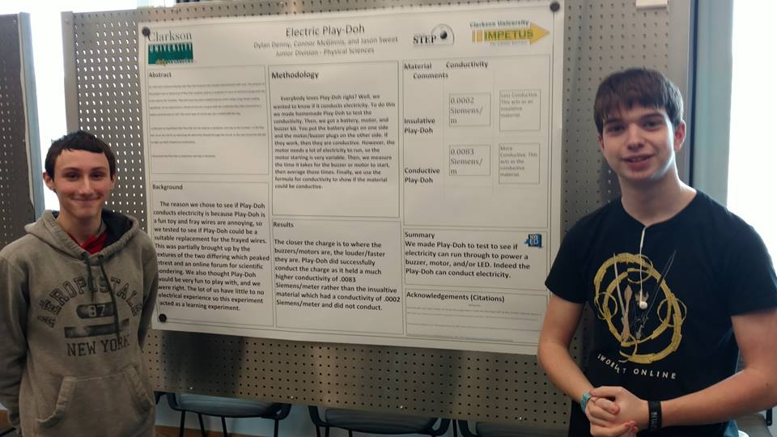
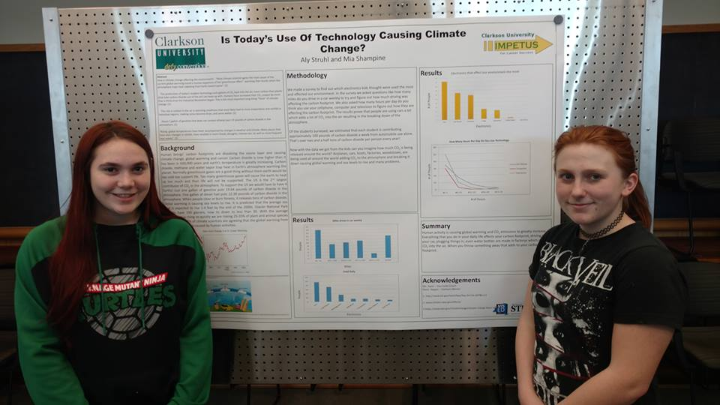
Clarkson discovery challenge
The CDC and showcase in March is another very popular part of IMPETUS!
CDC motivates students to participate in their own original research – leading to all sorts of interesting projects and outcomes!
Abstract deadlines are coming up quickly! The first draft is due in December!!!

Slide 6
Getting started with CDC
If you haven’t already, go to the IMPETUS Moodle page and locate the Clarkson Discovery Challenge course!
Once you’ve found it, complete:
“Registration Form”
Download “Research Guide”
Download “Research Worksheet” and fill out the first three sections (Question, Hypothesis, Experiment)

Slide 7
CDC Continued
Your first major task in the CDC is to write an abstract, but that takes a lot of work!
Read through pages 15-18 of the guidebook to understand what an abstract is and what goes into it.
Filling out the first few sections of the research worksheet is a good start to an abstract – helping you answer some of the major questions first

Slide 8
Integrated Clarkson Experience
ICE is a part of the IMPETUS program for 10th, 11th, and 12th graders as you get closer to considering life after college
Students in ICE are paired with a Clarkson student mentor and can attend special campus visits and tours
Last year, we went to Clinton Community College and SUNY Plattsburgh!
You can learn about upcoming events on our Facebook page! Check it out!

Slide 9
ICE CONTINUED
Jump on the ICE Facebook page and friend us!
Find the post for PARTY PACK, and leave a comment about why you want to go to college!
Already in ICE?! Remember that you can earn points on your ICEport for commenting on posts on the ICE Facebook page!!!

Slide 10
Problem of the week
You can do POW on any computer (or phone) that has internet access!
Weekly problems remain open so you can go to previous weeks’ questions even if you miss them during that particular week!
POW usually requires either some investigative research online OR some handwritten calculations (sometimes both!)
Go to the IMPETUS Moodle page and try out this week’s POW!

Slide 11
Khan Academy Challenge
KAC can also be done on any computer (or phone) with internet access!
Go to the Khan Academy site and make sure you have set up a profile AND added the IMPETUS course(s) to your account
Try a few lessons or begin a mission! See if you can level up and earn a few badges!

Slide 12
GO EXPLORE!
Get involved in the different parts of IMPETUS!
The more you participate, the more prizes you become eligible for!
Remember: they all count toward your IMPETUS passport!

