Slide 1
Research and the Scientific Method
Clarkson Party Pack

Slide 2
What is scientific research?
It comes in TWO flavors:
Pure scientific research is about trying to understand and explain the world around us
Applied scientific research looks for answer to specific questions
This is the type of research we are mainly concerned with
Explore this site to learn more!

Slide 3
Applied Scientific Research
Some examples of applied questions:
What is the fastest route from my house to school?
What breakfast foods give you the most energy?
What is the most popular lunch option in the cafeteria?
What type of joke makes people laugh the most?
What time of day are people most awake?
How can we predict which baseball team will win the World Series?
When is the best time to go to the grocery store to avoid lines?

Slide 4
Your Own Questions
Go through the brainstorming activity to come up with your own question (OR QUESTIONS):
List some of your favorite things to do
What are some current events, news items, or personal opinions that you are passionate about?
What are some things you are curious about?
NOW think about how to turn one (or more) of these items into a RESEARCH question where NEW knowledge is uncovered!

Slide 5
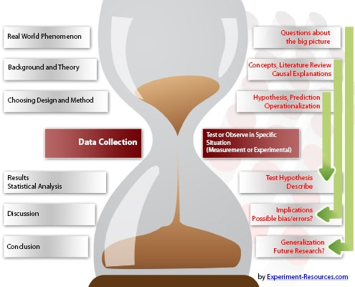
Scientific method
NOW you have a testable question about some real world phenomenon!
We need to be sure we can apply the scientific method to it
Let’s review what that is →

Slide 6
Steps in Research
Form a QUESTION
Collect relevant BACKGROUND information
Make a HYPOTHESIS
Design/conduct an EXPERIMENT to help you test the hypothesis
Collect DATA
Interpret and ANALYZE your results
Make CONCLUSIONS
Repeat and revise the hypothesis/experiment as needed!

Slide 7
Finding Background information
With a question in mind, start trying to learn as much as you can about the general topic you are concerned with!
Has your question already been answered?
Does previously conducted research exist?
Do you want to repeat an experiment?
Do you want to change/improve an experiment?
What facts are already known?
What theories already exist?
Why would someone care about the answer to your question?
What impact could finding the answer have?
Can it help others in some way?
Use scientific articles and verified sources (Google Scholar, encyclopedias, textbooks) to help you find these answers

Slide 8
Hypotheses
This might be a question, a statement, or an ‘If/Then’ claim
Examples:
Is over-fishing causing a decline in the stocks of Cod in the North Atlantic?
Over-fishing affects the stocks of cod.
If over-fishing is causing a decline in the numbers of Cod, then reducing the amount of trawlers will increase cod stocks.

Slide 9
Experimentation
An experiment should satisfy the following criteria:
The “sample” collected for testing should be obtained randomly
There must be a viable “control” group
Do not try to test too many variables at a time
One variable existing between each experimental group and the control is recommended
Test subjects are randomly assigned to experiment and control groups
The experiment must be repeatable (others should get similar results if they attempt it)

Slide 10
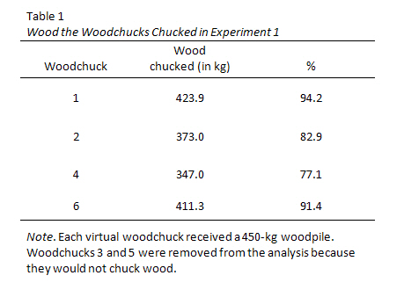
DATA and Analysis
Data should consist of information observed during the course of the experiment
Numerical (measurements)
Heights, weights, speeds, amounts, ratings (1-10)
Categorical (responses, descriptors)
Yes/No, color, shape, gender
You should use some kind of STATISTICS to analyze your data
Make graphs/tables/figures showing results
Clearly present what you LEARNED

Slide 11
Conclusions
Did you confirm or refute your hypothesis?
What errors may have occurred during experimentation?
How might the experiment be improved/changed?
What related questions might you want to answer next?
You MAY wish to answer these questions by conducting additional experiments
You will increase the validity of your results
You will learn even more information
You will be more convincing when presenting your findings to others

Slide 12
Presenting your results
Collect all the information you have obtained while carrying out the SCIENTIFIC METHOD
Publish/summarize your results in at least one of the following:
A paper
A talk
A poster
Be prepared to receive criticism and be asked questions!!!
This is one of the most important parts of the scientific process

Slide 13
Did you confirm or refute your hypothesis?
What errors may have occurred during experimentation?
How might the experiment be improved/changed?
What related questions might you want to answer next?
You MAY wish to answer these questions by conducting additional experiments
You will increase the validity of your results
You will learn even more information
You will be more convincing when presenting your findings to others

